Slide 1

Survey And Database Management
Muhammad Ahsan Ali
Hanana Asif
Emama Nugman

Slide 2
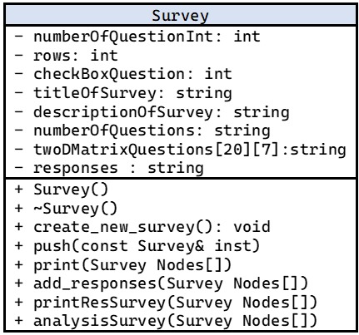
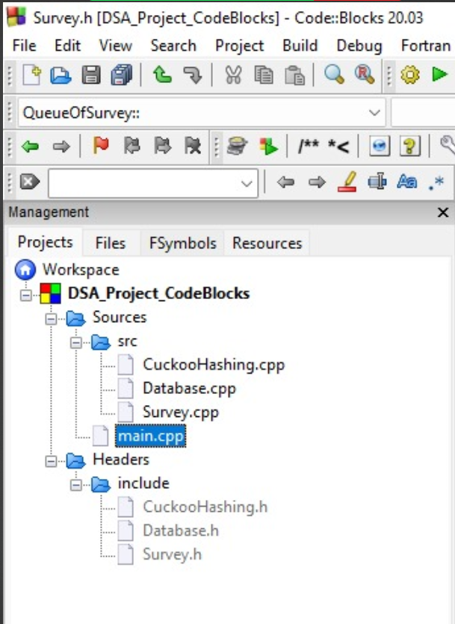
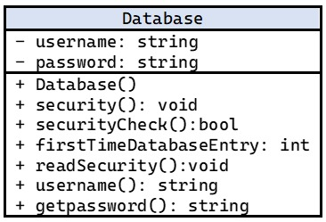
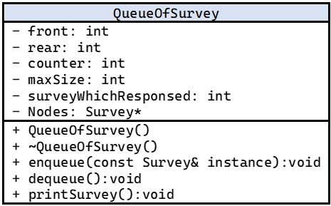
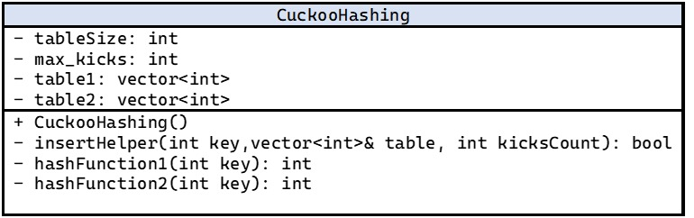
All About the Project & Code Flow:

Slide 3
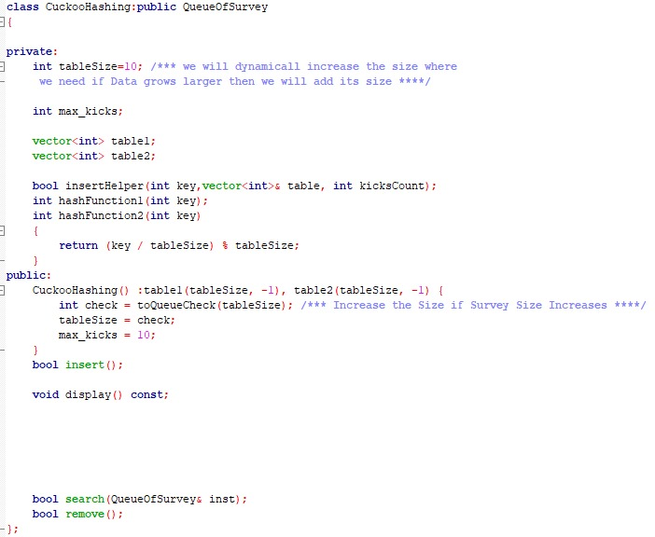
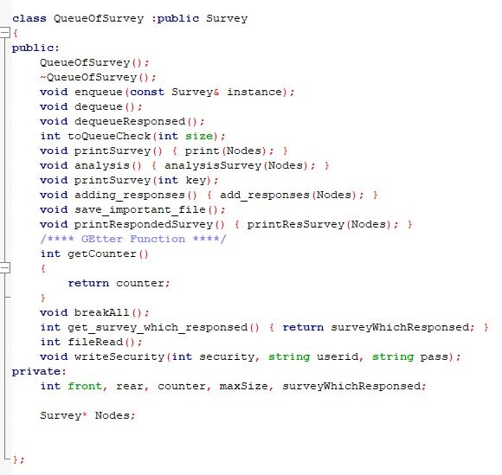
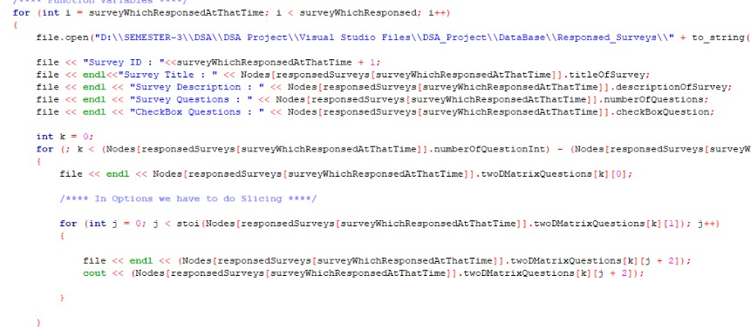
DATA STRUCTURES USED
ADDITIONAL CONCEPTS
Queues
Dynamic Arrays
Hashing
Vectors
Classes
Inheritance
File Handling

Slide 4
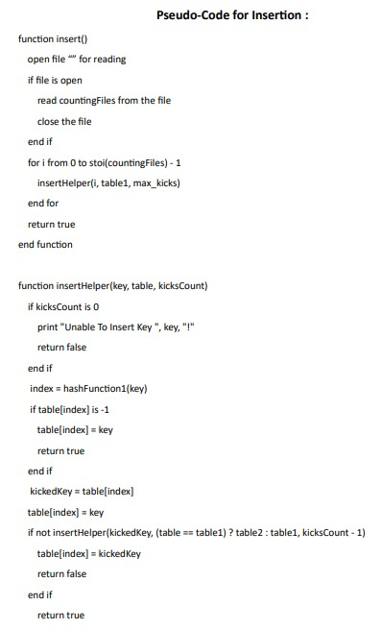
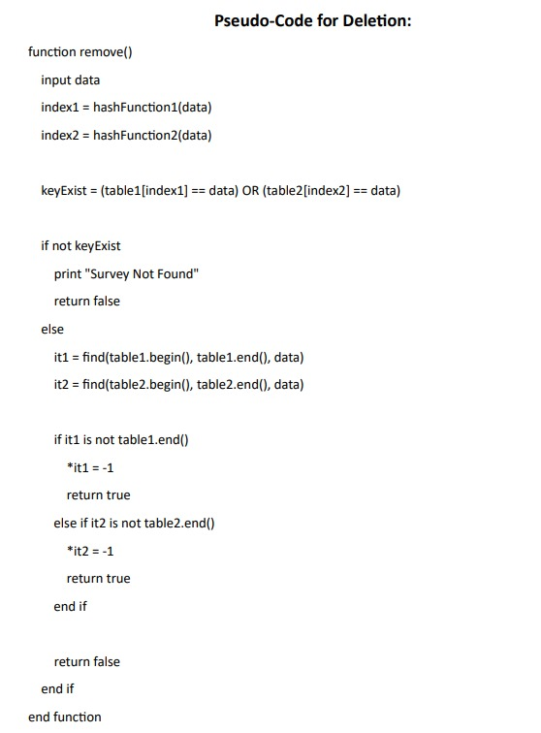
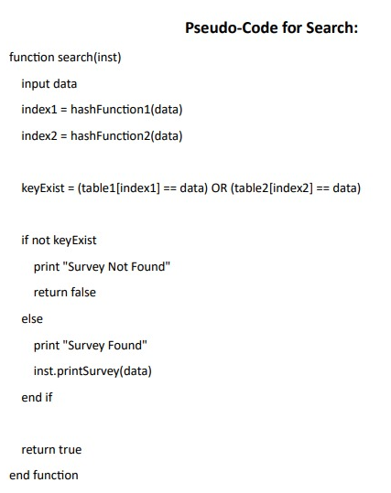
ALGORITHMS

Slide 5
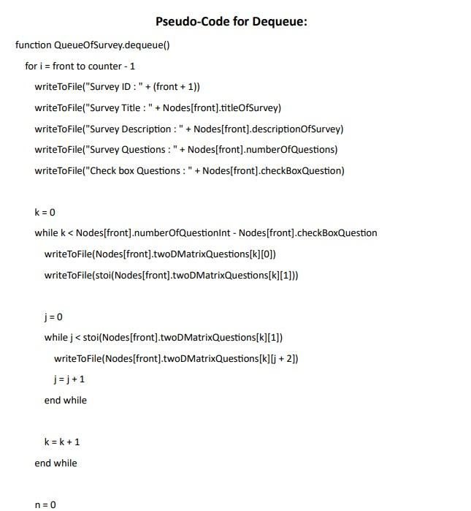
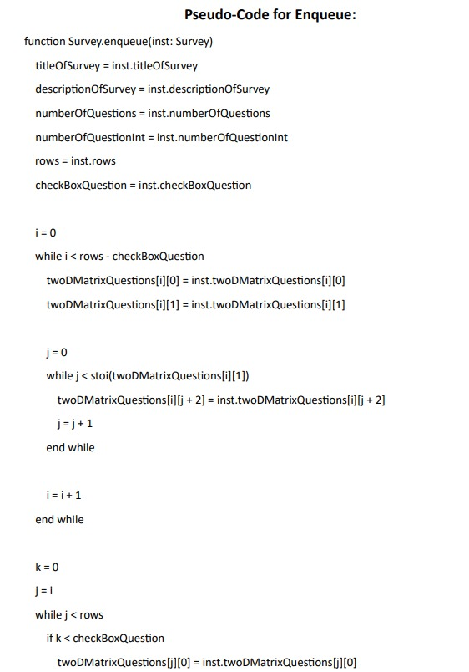
ALGORITHMS

Slide 6
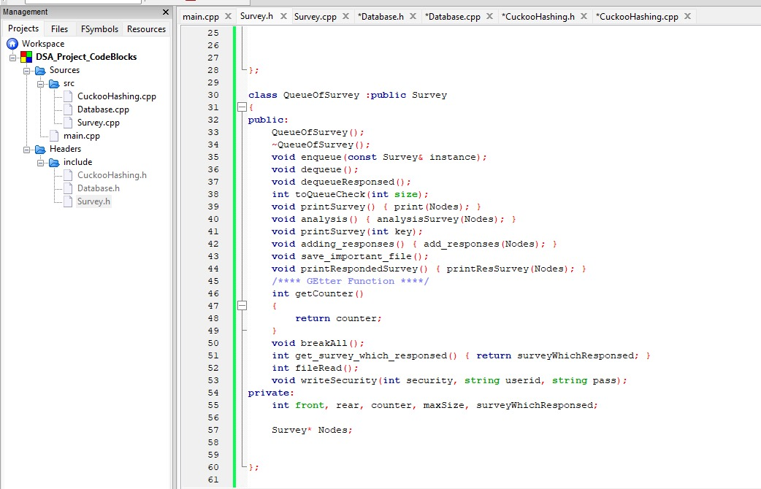

Why are we using these Data Structures ?
Queues
Enqueue & Dequeue
Worst Case Time Comlexity $O\left(1\right)$
Worst Case Space Comlexity $O\left(1\right)$
FIFO Nature
Playing role as a buffer
Queue with dynamic array which doubles when half-filled
Why not Queue with linked list?
Consecutive memory access
Depending on use-case
Why not vectors?
Project Requirement is FIFO
Insertion & Deletion are not required in Survey Management
Insertion & Deletion takes linear time in vectors

Slide 7
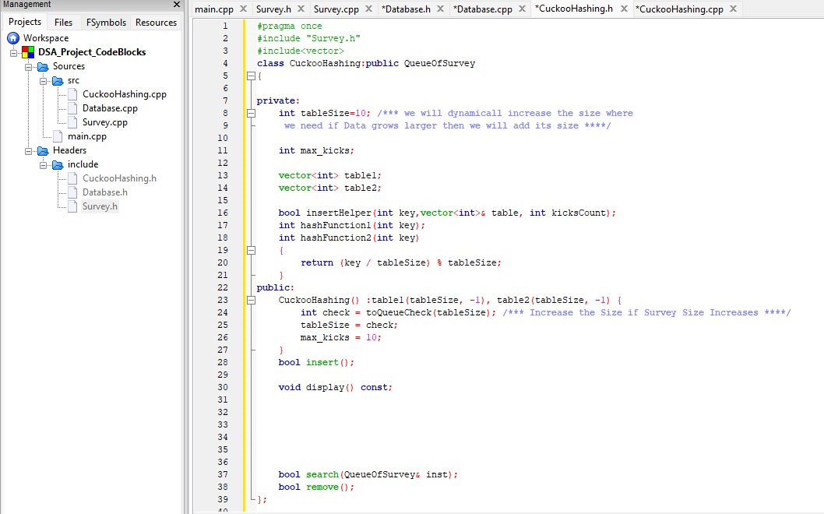
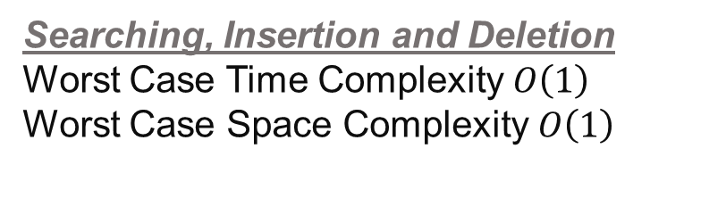
Why are we using these Data Structures ?
Cuckoo Hashing
Searching, Insertion and Deletion
Worst Case Time Complexity $O\left(1\right)$
Worst Case Space Complexity $O\left(1\right)$
Double Hashing Table
Key Value Pairs
Why not Trees(e.g. BSTs)?
In large data sets it provides constant time complexity
In our use-case constant time complexity is important than order
Why Cuckoo Hashing?
Uses two hashing tables
Guarantees Constant Time complexity
Overcome Collisions

Slide 8
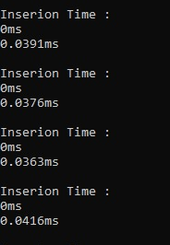
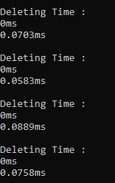
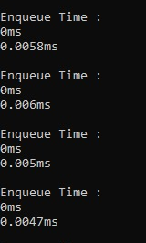
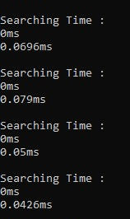
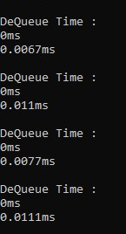
Time Complexity

Slide 9
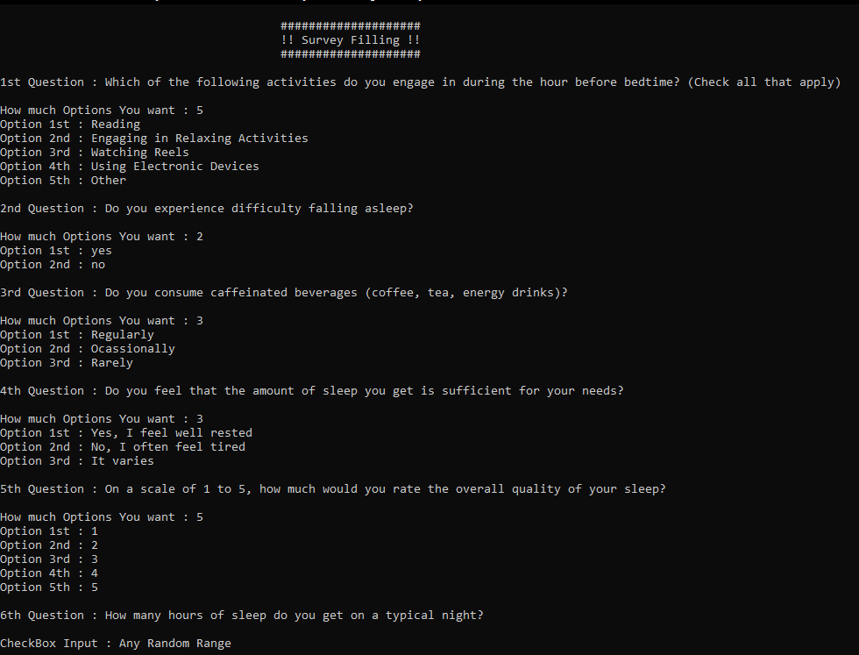
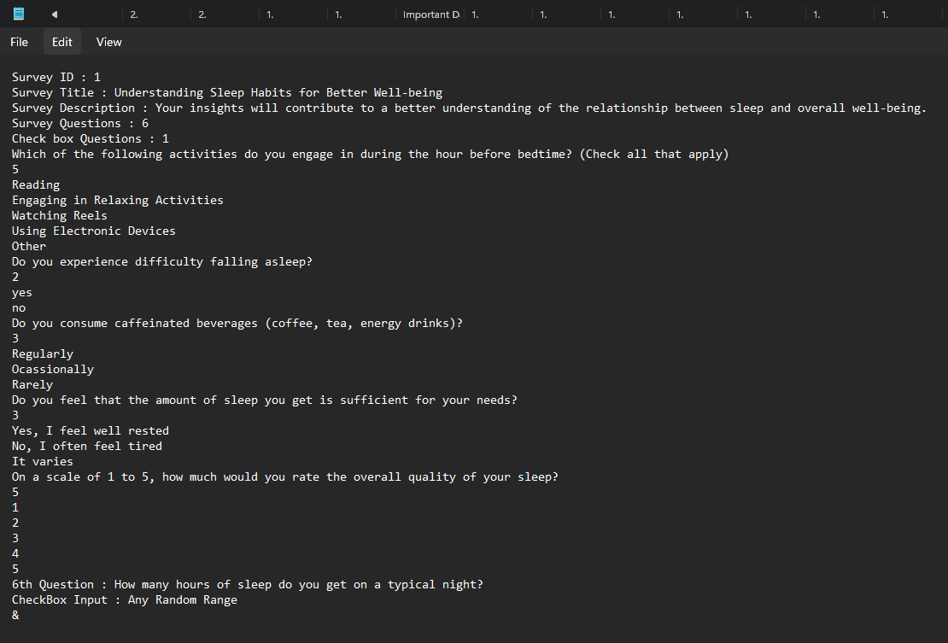
Practical Application
Survey Entry on Console
Survey Dequeue by File Handling

Slide 10
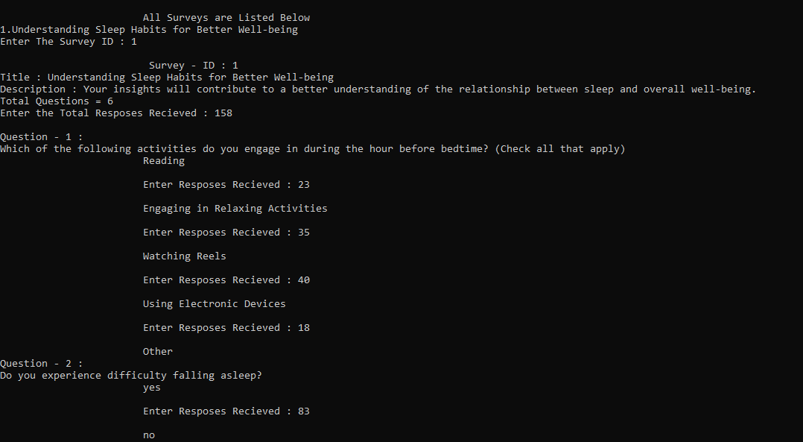
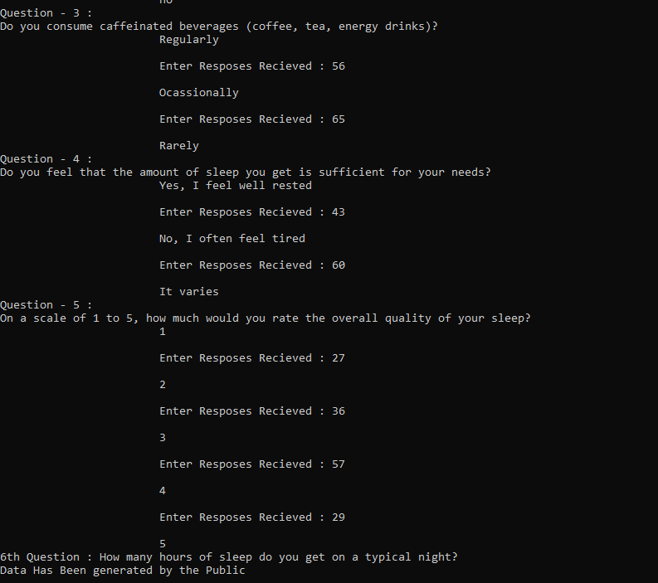
Practical Application
Adding Responses

Slide 11
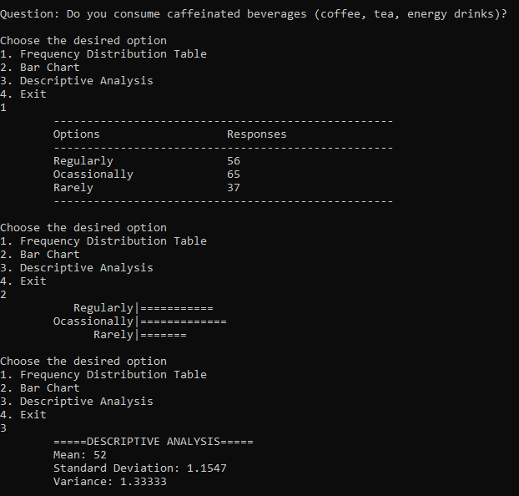
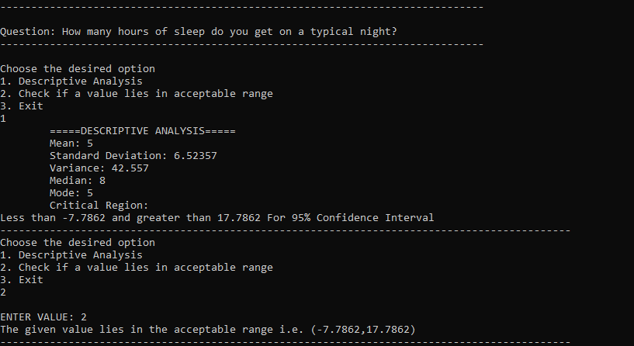
Practical Application
Survey Analysis

Slide 12
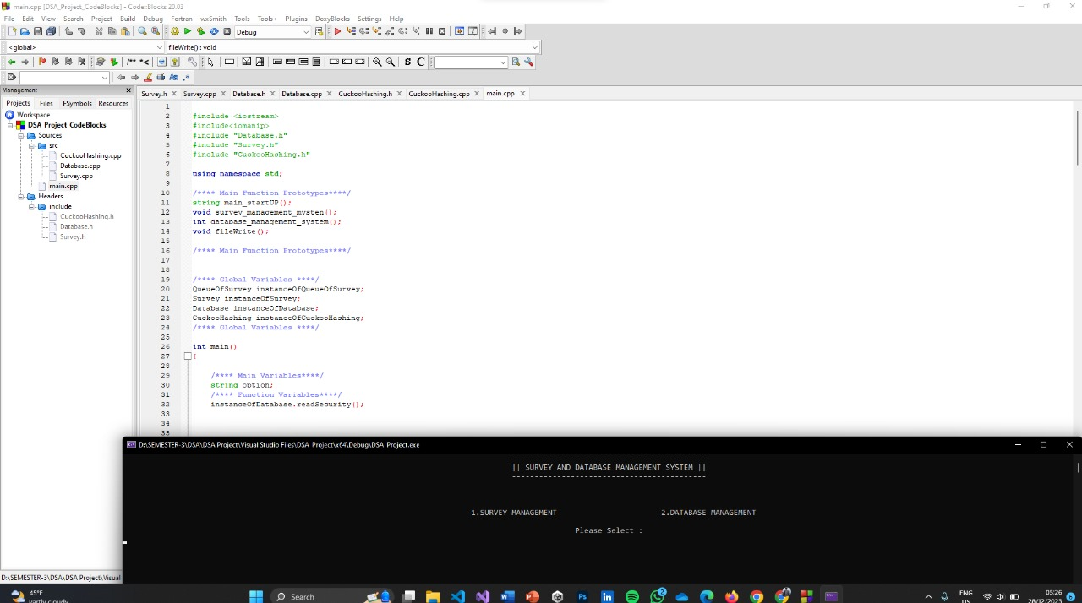

Slide 13
Thank You

